Slide 1




Routing
Angular Basics

Slide 2

Table of Contents
What is a route in SPA application
What is a template / partial view
Creating routes
Using route parameters

Slide 3

What Is a Route

Slide 4
What Is a Route
In SPA applications route is
Path to part of the SPA
Not mapped URL to specific file or resource
Descriptive for the end user
Provides history and copy-paste functionality

Slide 5

What Is a Template

Slide 6
What Is a Template
Templates are:
Partial HTML files
Contain only part of the web page
Usually are rendered through AJAX / caching
Rendered in a "parent" HTML / view
Saving repetitive code

Slide 7

Creating Routes

Slide 8
Creating Routes
Include the module (different script file)
Create Routes per module
var myApp = angular.module('myApp', ['ngRoute'])
.config(function($routeProvider) {
$routeProvider.when('/route', {
templateUrl: 'templates/partial.html',
controller: 'myController' // optional
});
$routeProvider.otherwise({redirectTo:/home'});
});

Slide 9
Creating Routes
Create index.html (or default page) per module
Include all scripts
Put ng-view directive
<div ng-app="myApp">
<div ng-view>
// all partials will be rendered here
</div ng-view>
</div>

Slide 10
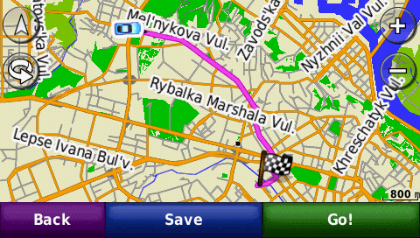
Route Parameters

Slide 11
Route Parameters
Route parameters start with ":"
You can use them later in controllers
$routeProvider.when('/partial/:a/:b/:c', {
templateUrl: 'templates/partial.html',
controller: 'myController',
myApp.controller('myController',
function myController($scope, $routeParams) {
$scope.a = $routeParams.a;
$scope.b = $routeParams.b;
}
);

Slide 12
Summary
Angular routes
Creating routes
Accessing route parameters

Slide 13
AngularJS
http://academy.telerik.com

Slide 14
Exercises
Convert EditProfile.html from a stand-alone page to a template, add a route and link to the new route.
Create a route that requires no template or controller, such as a “site version” page or simple “about” page. (hint: Use ‘template’ instead of ‘templateUrl’)
Fix the home page listing of artists with a better solution (if there are more than three artists, they should be placed in different rows)
Implement searching and filtering the home page listing of artists

